Slide 1
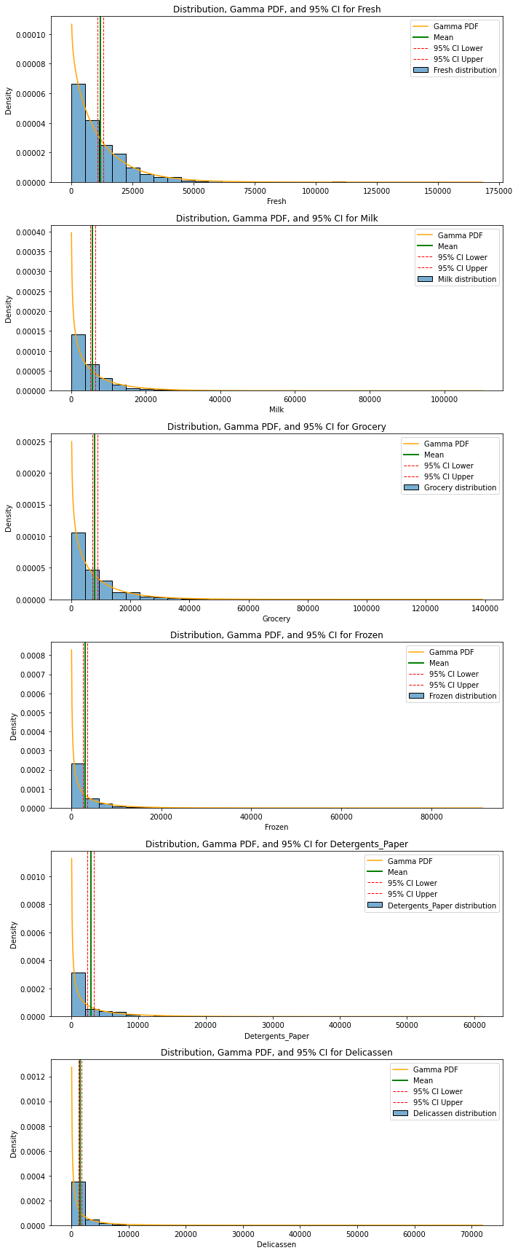

For Fresh: 95% confidence interval = [10795.79, 13204.8], mean = 12000.3
For Milk: 95% confidence interval = [5093.37, 6499.16], mean = 5796.27
For Grocery: 95% confidence interval = [7046.22, 8856.34], mean = 7951.28
For Frozen: 95% confidence interval = [2609.58, 3534.28], mean = 3071.93
For Detergents_Paper: 95% confidence interval = [2427.41, 3335.57], mean = 2881.49
For Delicassen: 95% confidence interval = [1256.29, 1793.45], mean = 1524.87
We recommend following these confidence intervals to maintain proper inventory
Notes:
We understand how important is to know how to prepare inventory throughout a given year, and for this we decided to create sampling distributions of all products sold in order
to have a better understanding of how the averages might fluctuated within the sales period. We conducted the simulation based on the nature of the distribution of the products and
decided to apply a Gamma function distribution since it is the visualization that better represents the products population.
The results of the simulated distribution, using previously know measurements of central tendency and dispersion we built confidence intervals at a 95% confidence level. With these results
We are 95% confident that the mean of each product will fall between these intervals. With this knowledge, it is up to you if you want to maybe, under-stock or over-stock some of these
Products but before you do decide. Please allow us to conclude this analysis.

Slide 2
Contingency Table and Chi-Squared Results:
 | Region 1 | Region 2 | Region 3
Channel 1 | 59 | 28 | 211
Channel 2 | 18 | 19 | 105
Region 1 Region 2 Region 3
Channel 1 52.15 31.831818 214.018182
Channel 2 24.85 15.168182 101.981818
df 2
P-value 0.11365689324243589
statistic 4.349142154535748
Notes:
The marketing department requested to conduct a Hypothesis test to see if there was any dependency between the Region and Channels when it came to selling these products
We then conducted a Chi-square test, to test for dependency of these categorical variables and found out the Following:
P-Value: .099 A not statistically significant results at alpha = .05
Chi-square Statistics: .009
With these results, we failed to reject the Null Hypotheses, there is no association between channel and Region. This led us to conclude a marketing strategy. The strategy involved in starting a marketing campaign to push lowest sold products with the same design to all channels and regions, without the need to adjust for specific targeted marketing which can save time and money due to its simplicity in marketing.

Slide 3
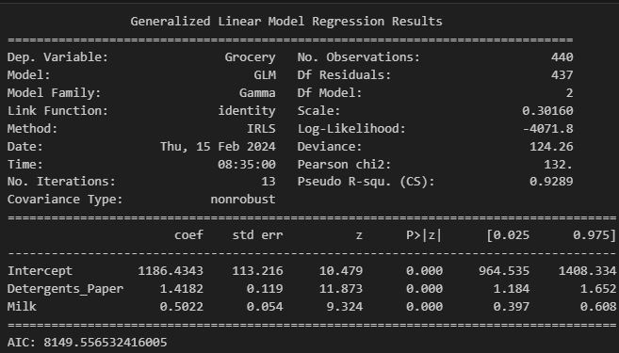
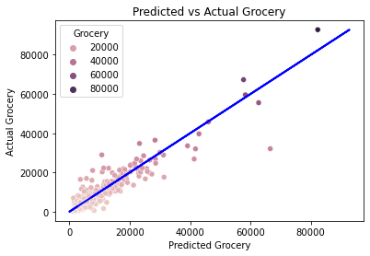
Forecasting Equation:
Groceries = 1186 + 1.42(Detergents/paper) + .50(Milk) Monetary Units
Notes:
Since we know that fresh is the most dominant product on all three regions and both channel 1 and channel 2. It will be beneficial for us to predict the second most consumed product
which are groceries. We can predict how much groceries are going to be consumed based on the correlated product, detergents and paper.
Detergents and paper is also correlated to milk and seems like people often purchase groceries, milk and detergent and paper in conjunction. We found by evaluating an ordinary least square model against a general linear model with the Gamma family and identity link function that the AIC result of 8149.55 was better fit using the GLM with the explanatory variable Detergents_Paper and Milk.
With this model you will be able to over-stock in case there is a sudden increase in detergents and paper. It is worth noting that since detergents and paper are also correlated with milk, you should expect a more aggressive increase of consumption on detergents and paper along with groceries in case there is a sudden increase in milk consumption.

